Slide 1
Detection of iron deficiency anemia by medical images
Link to the paper

Slide 2
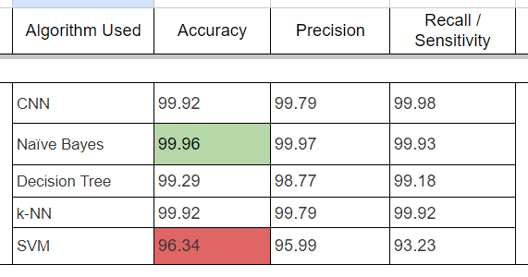
AIM
CONCLUSION
Using the pallor of the palm to detect anemia using machine learning algorithms through a comparative study of Decision Tree, SVM, Naïve Bayes, k-NN and CNN
All of the proposed models used in the study produced or achieved significant results
Naïve Bayes attained 99.96% accuracy which is the highest among all the models
k-NN and the CNN both had an accuracy of 99.92% each

Slide 3
Preprocessing
Feature Selection
After collecting the images, the triangle thresholding approach was used to extract the features of the palm images to generate the ROI
Then image augmentation technique was done on the original datasets, which includes rotation, flipping, and translation, to expand the size of the original datasets
Next, the extracted Region of Interest (ROI) is divided into metrics through the utilization of the CIE L*a*b* colour space intensity value of the pictures (The L*a*b colour space is intended to simulate human eyesight or perception).
There is a strong relationship between a* components and Hb levels when calculated using the Pearson Correlation Index
The best classifying result was reached after numerous trials by integrating three-component features in total, namely a*, b*, and the G value derived from the RGB component photos
The L and RGB component values were retained for filtering the incoming data.
The mean values of the characteristics a*, b*, and G were carefully calculated by considering just the image pixels with minL < L < maxL and min < R = G = B < max.
This last filtering guarantees that image pixels that are abnormally dark or bright are deleted

Slide 4
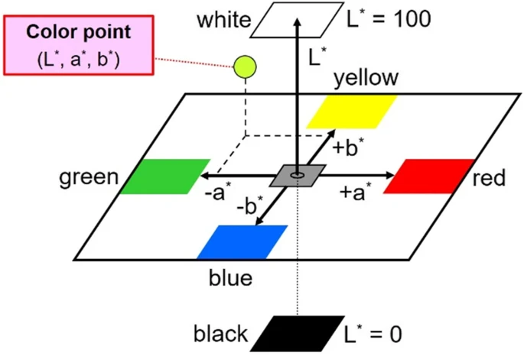
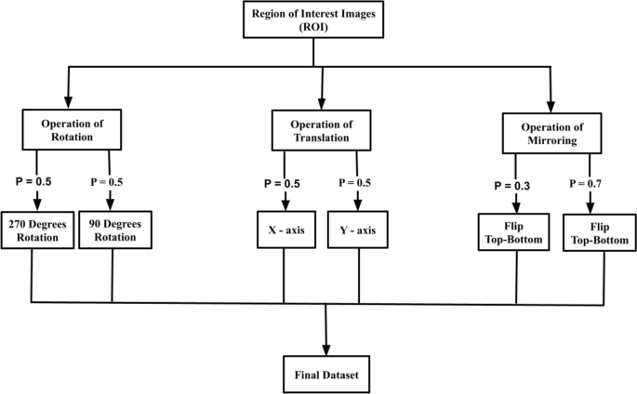
CIELab color space
Data Augmentation

